Slide 1
Chapter 3: Neurons, Neural Networks, and Linear Discriminants
3.4 LINEAR SEPARABILITY & 3.5 LINEAR REGRESSION

Slide 2
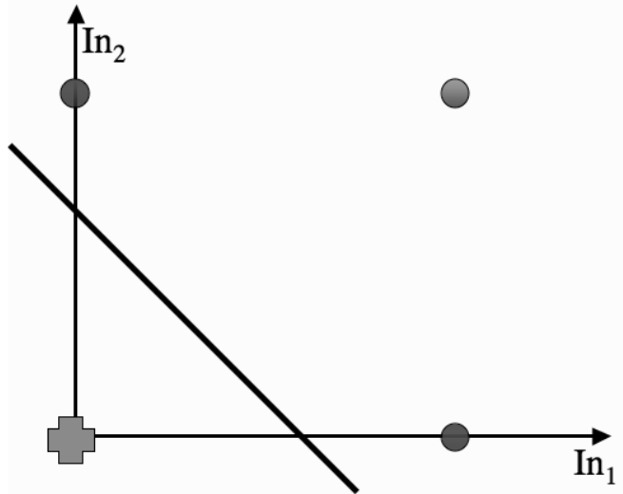
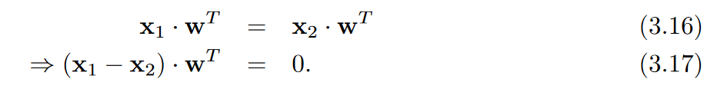
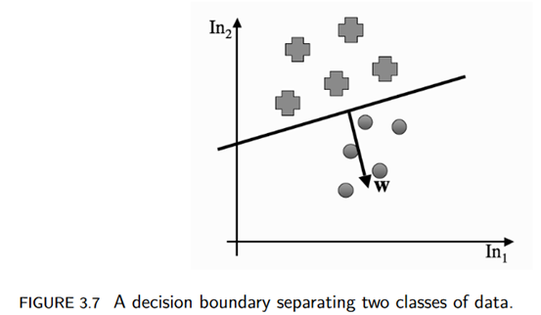
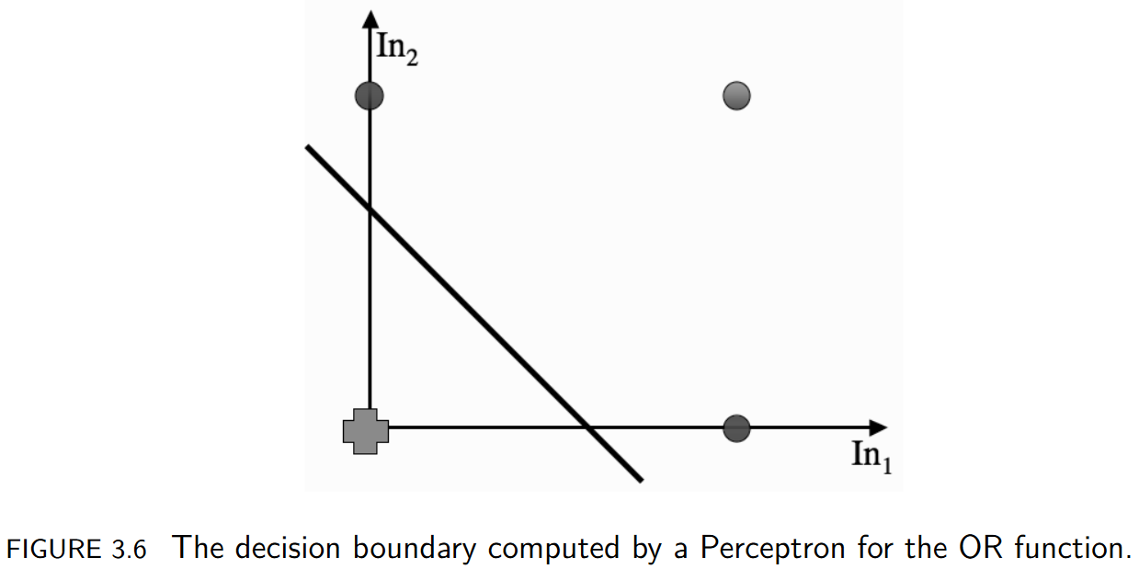
What does the Perceptron actually compute?
3.4 LINEAR SEPARABILITY
Finds the decision boundary where neuron fires on one side and doesn’t on the other.
Scalar product a·b=‖a‖‖b‖cosθ, where θ is the angle between a and b and ‖a‖ is the length of the vector a. If not ‖a‖=0 or ‖b‖=0 then θ=π/2 or−π/2 (two vectors are at right angles).
The neuron fires if x·wT≥0 => Perceptron boundary case is where we find an input vector x1 that has x1·wT= 0.

Slide 3
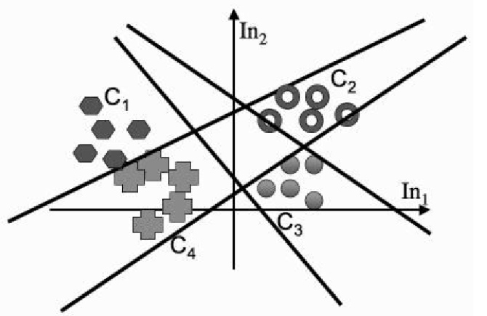
What does the Perceptron actually compute?
3.4 LINEAR SEPARABILITY
Single neuron perceptron = 1 decision boundary
Finds the decision boundary where the neuron fires on one side and doesn’t on the other.
Each neuron in the perceptron separately describe a straight line.
Four neuron perceptron = 4 decision boundaries

Slide 4

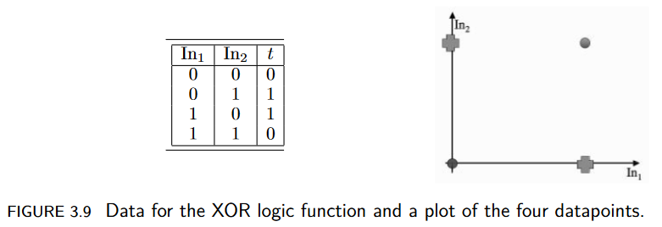
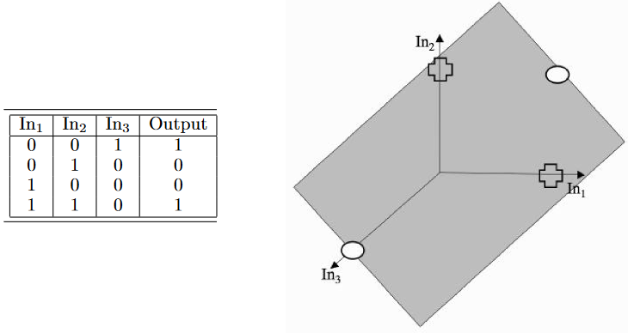
The Exclusive Or (XOR) Function
Perceptions find linear decision boundaries. What if the classes are not linearly separable? (decision boundary is a straight line) The algorithm does not converge!
For the XOR, One solution: Rewrite the problem in 3 dimensions instead of two (show in figures above).
In fact, it is always possible to separate out two classes with a linear function, provided that you project the data into the correct set of dimensions (basis of kernel classifiers, Support Vector Machines).

Slide 5
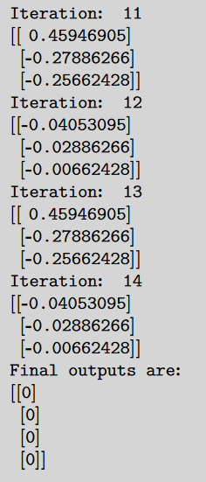
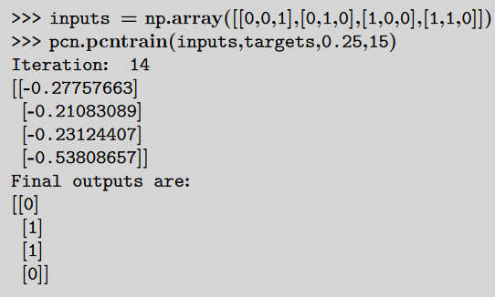
2D XOR input
3D XOR input

Slide 6

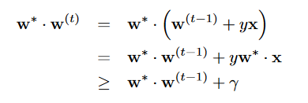
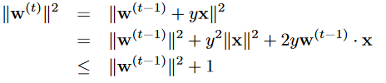


The Perceptron Convergence Theorem
Rosenblatt’s 1962 proof that, given a linearly separable dataset, the Perceptron will converge to a solution that separates the classes, and that it will do it after a finite number of iterations, bounded by 1/γ^2, where γ is the distance between the separating hyperplane and the closest datapoint to it.
Linearly separable: know that there is some weight vector w∗ that separates the data.
Using product w∗·w, when the two vectors are parallel, the angle between them is θ= 0 and so cosθ= 1, and so the size of the inner product is a maximum.
Proof to show that at each weight update w∗·w increase & length w does not increase too much.
Check w∗·w increases
Check length of the weight
Where γ is that smallest distance between the optimal hyperplane defined by w∗ and any datapoint
Where γ is that smallest distance between the optimal hyperplane defined by w∗ and any datapoint

Slide 7
Pre-processing: Data Preparation
Scaling the data (Two methods):
Min-max scale between max 1 and min -1 2(data – min / max)-1 highly sensitive to outliers
Data transformed to have a zero mean and a unit variance in each direction. (data – mean / std) a bit less sensitive to outliers
Looking at the data:
In the example data not many people had more than 8 pregnancies => make all values greater than 8 equal 8.
Group ages into age ranges.
Feature selection:
Subset of the inputs, missing out different features one at a time and seeing if that makes the results better. Remove completely one and repeat. (testing correlation between output and features) better methods later…

Slide 8
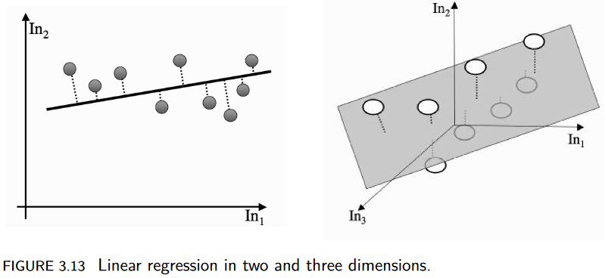
LINEAR REGRESSION
Regression problems: we fit a line to data
Classification problems: we find a line that separates out the classes to distinguish.
Can turn classification problems into regression problem with indicator variable.
Minimise the distance between each datapoint and the line that we fit.

Slide 9
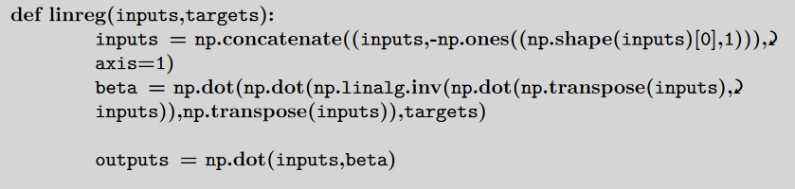
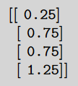
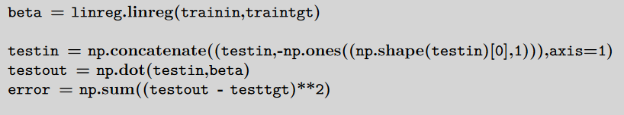
LINEAR REGRESSION
XOR output
Testing the prediction using sum-of-squares error

